Slide 1

Introduction to Data Science and Machine Learning
Arusha,Tanzania
Zephania Reuben
December 02, 2021

Slide 2
Introduction
Types of Machine Learning
Machine Learning WorkFlow
What is the difference between DS, ML, AI, and DL?
Applications of Python
Python Libraries for DS and ML
Python Libraries for DL
Applications of ML/DL

Slide 3
Problem
”You need to predict how much user “A” will like a movie that she hasn’t seen based on her ratings of movies that she has seen.”

Slide 4
Ways to solve
Traditional Methods
Machine Learning

Slide 5
Traditional Methods
Complex rules
Hard to maintain

Slide 6
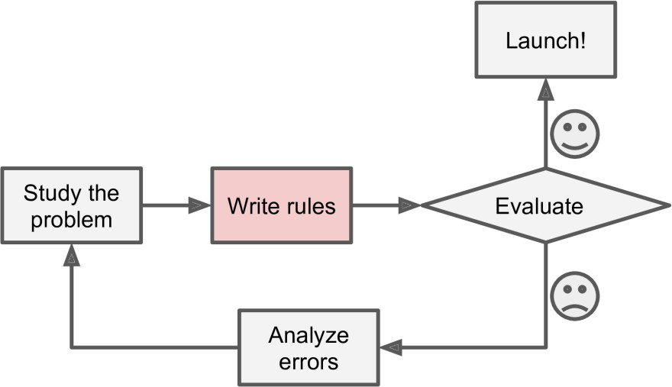
Traditional Methods

Slide 7
Machine Learning
Automatic pattern learning
Ease to maintain
Adopt to changes
More accurate

Slide 8
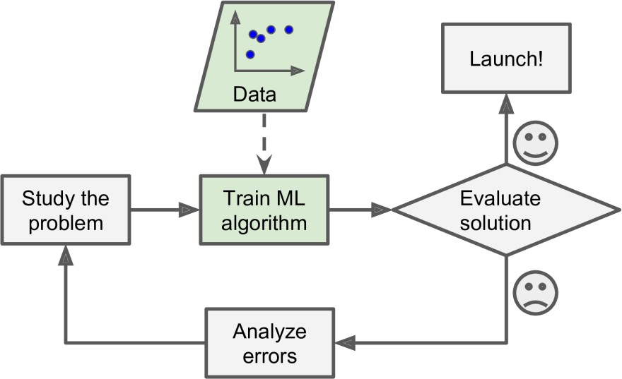
Machine Learning

Slide 9
Machine Learning
What does it mean tolearn?
In Machine Learning an important concept isGeneralization, the ability to generalize.

Slide 10
Machine Learning
A computer program is said to learn fromexperienceE with respect to sometaskT and someperformanceP, if its performance on T, as measured by P, improves with experience E.
- Tom Mitchell, 1997.

Slide 11
Checker Learning Problem
TaskT : Playing Checker.
ExperienceE: Playing practice game against itself.
Performance MeasureP: % of games won against opponents.

Slide 12
Types of Machine Learning
Supervised Machine Learning
Unsupervised Machine Learning
Semi-Supervised Machine Learning
Reinforcement Learning

Slide 13
Machine Learning Algorithms
Supervised Machine Learning Algorithms
Training data includes the desired solutions calledlabels.

Slide 14
Machine Learning Algorithms
Some Supervised Machine Learning Algorithms
Linear & Logistic Regression
Decision Trees
Support Vector Machines
Random Forest
K-Nearest Neighbors
Neural Networks

Slide 15
Machine Learning Algorithms
Unsupervised Machine Learning Algorithms
They onlyextracts patternfrom the provided data during learning.

Slide 16
Machine Learning Algorithms
Some Unsupervised Machine Learning Algorithms
Clustering
Anomaly Detection
Dimensionality Reduction

Slide 17
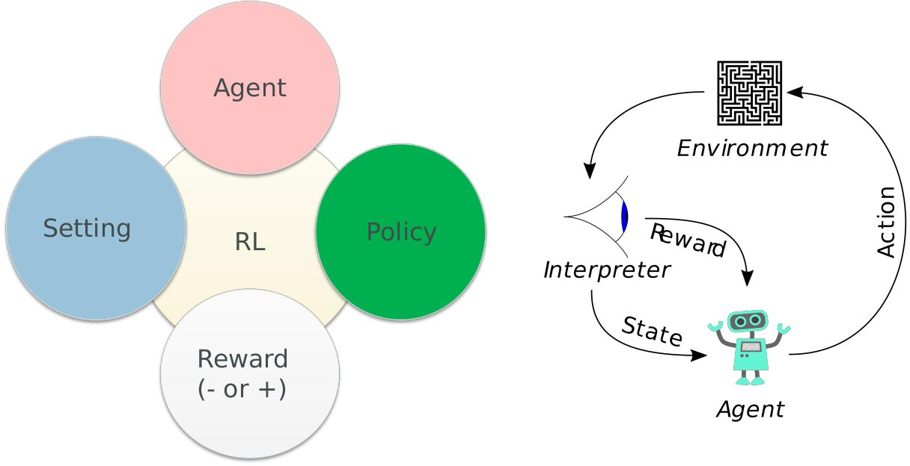
Reinforcement Learning Algorithm

Slide 18
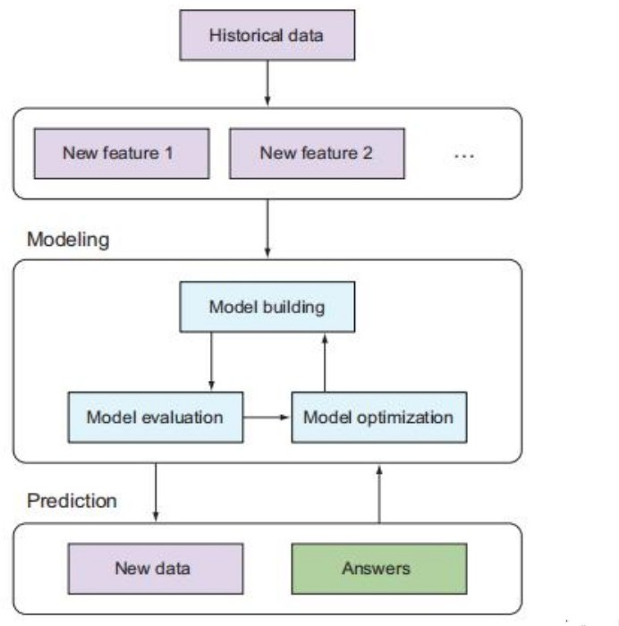
Machine Learning WorkFlow

Slide 19
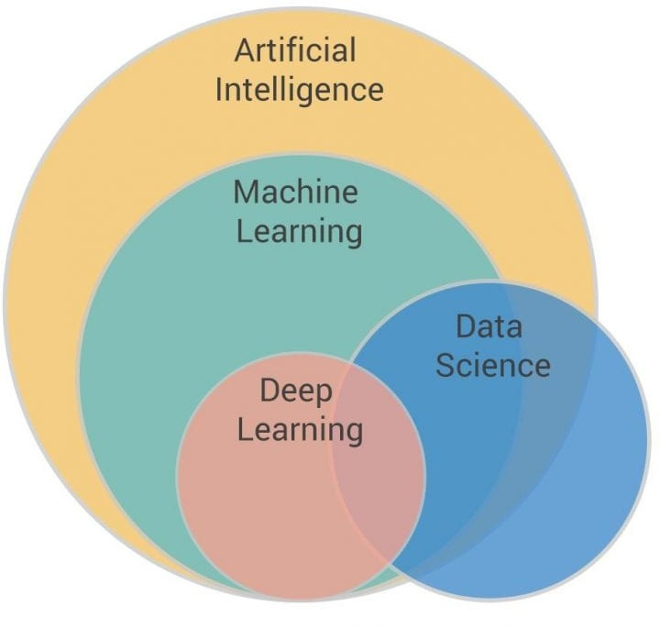
What is the difference between DS, ML,
AI, and DL?

Slide 20
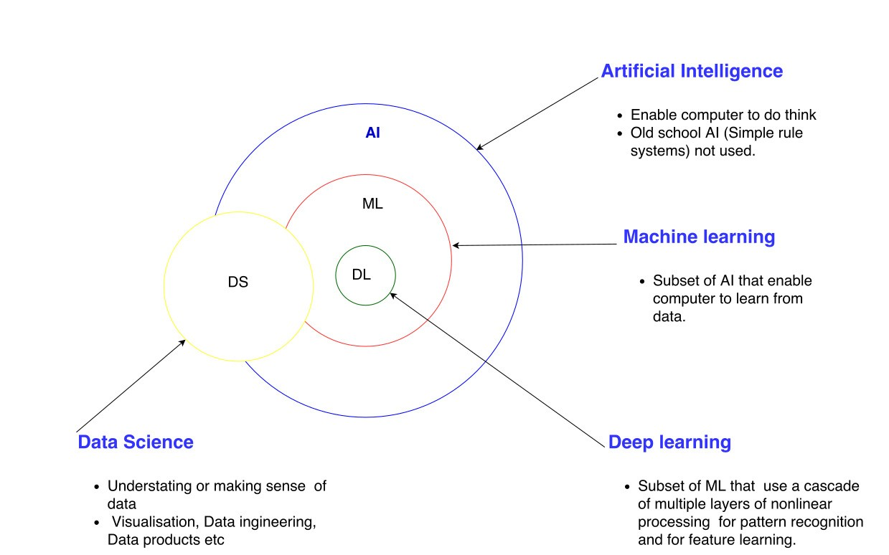
What is the difference between DS, ML,
AI, and DL?

Slide 21
Applications of Python
Web Development
Game Development
Machine Learning and Artificial Intelligence
Data Science and Data Visualization
Desktop GUI
Web Scraping Applications
Embedded Applications e,g IoT

Slide 22
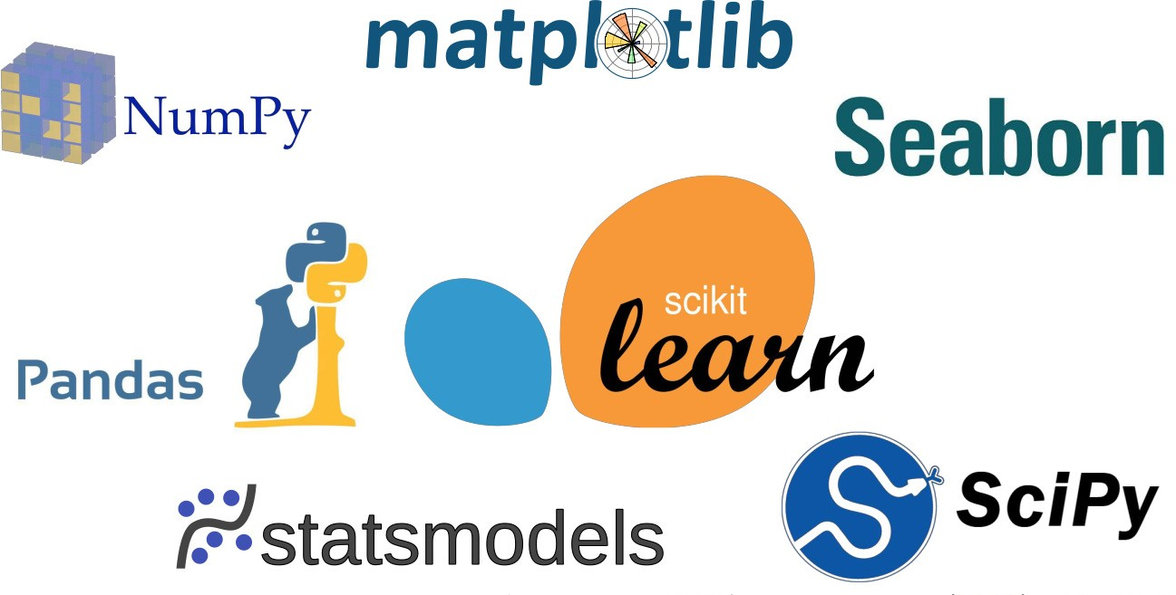
Python Libraries for DS and ML

Slide 23

Python Libraries for DL

Slide 24
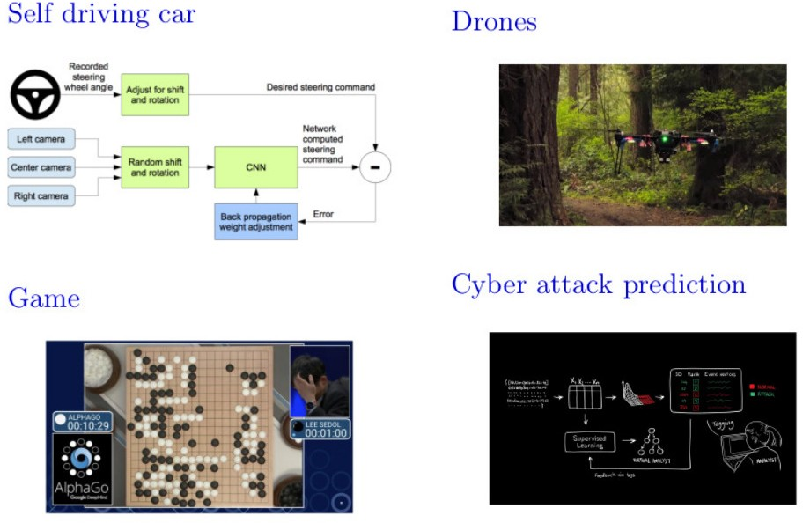
Applications of ML/DL

Slide 25
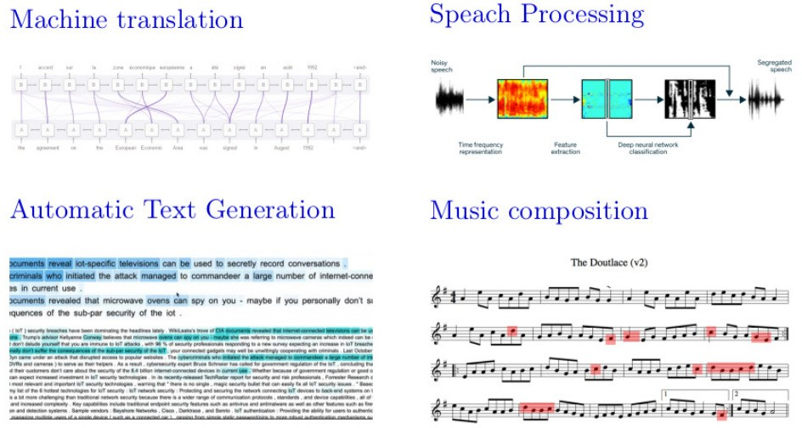
Applications of ML/DL

Slide 26
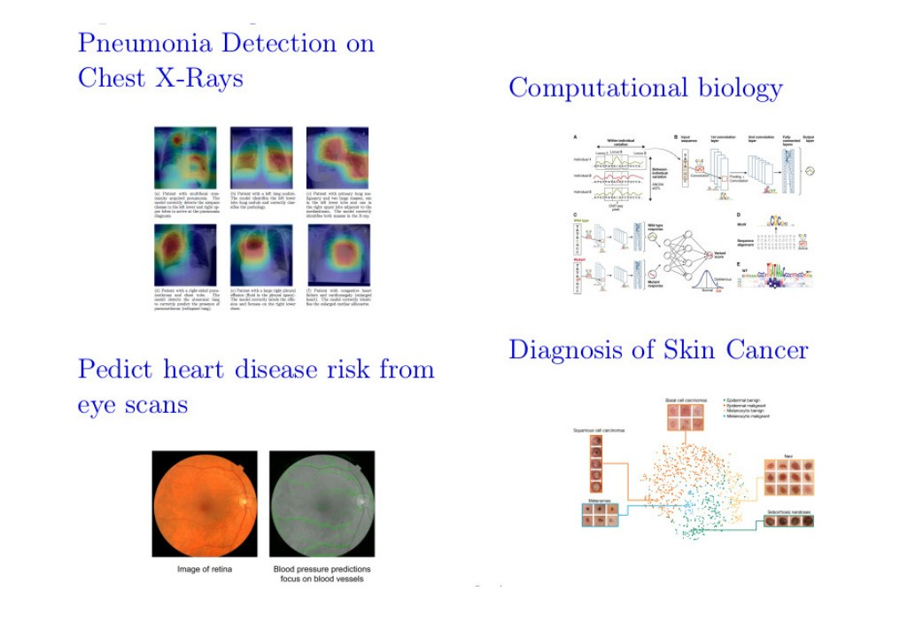
Applications of ML/DL

